Slide 1

Early Childhood State Advisory Council Update
January 14, 2026

Slide 2

Agenda
Federal Updates
State of the State + Budget Update
2026 Legislative Session
Looking Ahead–Upcoming Hearings
Child Care Works Update

Slide 3

Federal Update
Child Care Subsidy Payment Delay
UPDATE - the state has now received all delayed CCDF funds that Missouri’s Office of Childhood (OOC) requested to pay providers.
Earlier this month, the Administration on Children and Families delayed remitting child care subsidy funds to the OOC. Initially, it was announced in the media that all states would have their CCDF funds frozen due to allegations of fraud. The federal government later announced the freeze applied to five states: California, Colorado, Illinois, Minnesota, and New York.
Missouri was among the other states required to Defend the Spend and submit additional documentation prior to receiving funds.
Missouri Independent

Slide 4

Federal Update
Child Care Subsidy Rule Change
US Dept. of Health and Human Services is proposing the following amendments to child care subsidy rules implemented by the Biden administration.
Repeals the requirement to pay providers prospectively.
Repeals the requirement to pay based on a child’s enrollment.
Repeals the federally mandated cap on family co-payments
Repeals the requirement to use some grants or contracts for direct services.
Public comment on this rule change is open until Feb. 4.

Slide 5
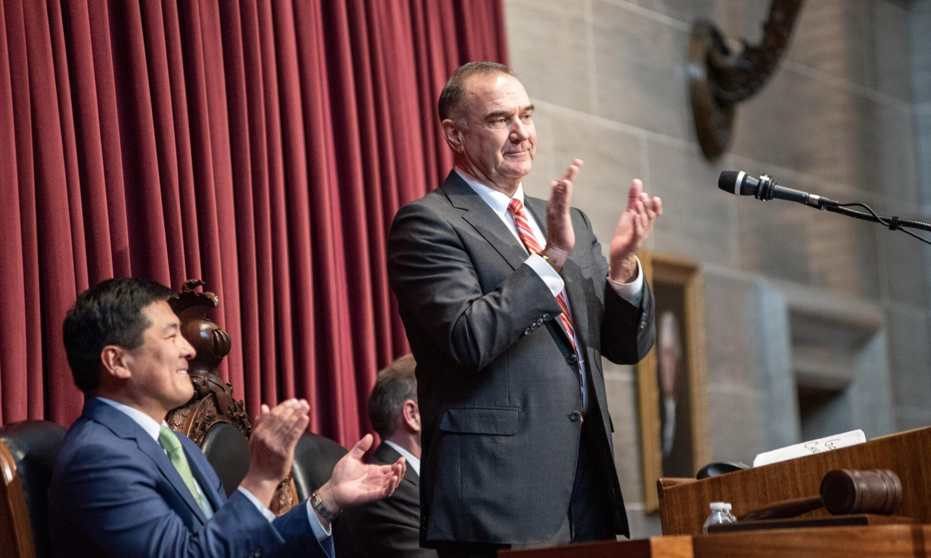
ECE Highlights from the SOTS and Governor’s Budget
Continued funding for the Child Care Subsidy Program
Sustained funding for the Missouri Quality Pre-K Program
Ongoing support for the Child Care Works program & Child Care and Early Education Community Planning
Photo: Missouri Independent/Annelise Hanshaw

Slide 6
Dynamics Impacting the 2026 Legislative Session
Fallout from the Previous Question (PQ) motions used during the 2025 regular session and the September extraordinary session.
Leadership races and transitions in both the Senate and House
State budget is tightening, something few current legislators have experienced.
Significant federal cuts to SNAP and Medicaid
Strong desire by Republican leadership to eliminate the income tax

Slide 7
Child Care and Early Education
Three Child Care Tax Credits
HB 2409 - Rep. Shields
Allergy Prevention in Child Care
HB 2249 - Rep. Ealy
HB 2365 - Rep. Schulte
HB 2490 - Rep. Webber
SB 1260 - Sen. Lewis
Safe Sleep in Child Care Facilities
HB 1819 - Rep. Laubinger
Summer Camp Provisions
HB 2190 - Rep. Murphy
HB 2398 - Rep. Schmidt

Slide 8
Child Care and Early Education
QR codes containing link to inspection reports at child care facilities
HB 2506 - Rep. Matthiesen
Early Education school district in St. Louis Co.
SB 898 - Sen. McCreery
Allows voters within a county or St. Louis City to approve an Early Childhood Education Fund
HB 2379 - Rep. Williams

Slide 9
Other Issues
K-12 Education
Multiple MO Scholars bills
Open Enrollment
Limited computer usage in K-5
Requires schools to provide education to students when suspended or expelled
Parental consent required for significant changes to IEPs
Accountability measures and performance-based funding

Slide 10
Upcoming Budget Hearings
Wednesday, January 14
House Budget (8:15am)
Supplemental (HB 2014) and the FY 2027 Governor’s recommended budget overview
Thursday, January 15
Senate Budget (8:15am)
FY 2027 Governor’s recommended budget overview

Slide 11
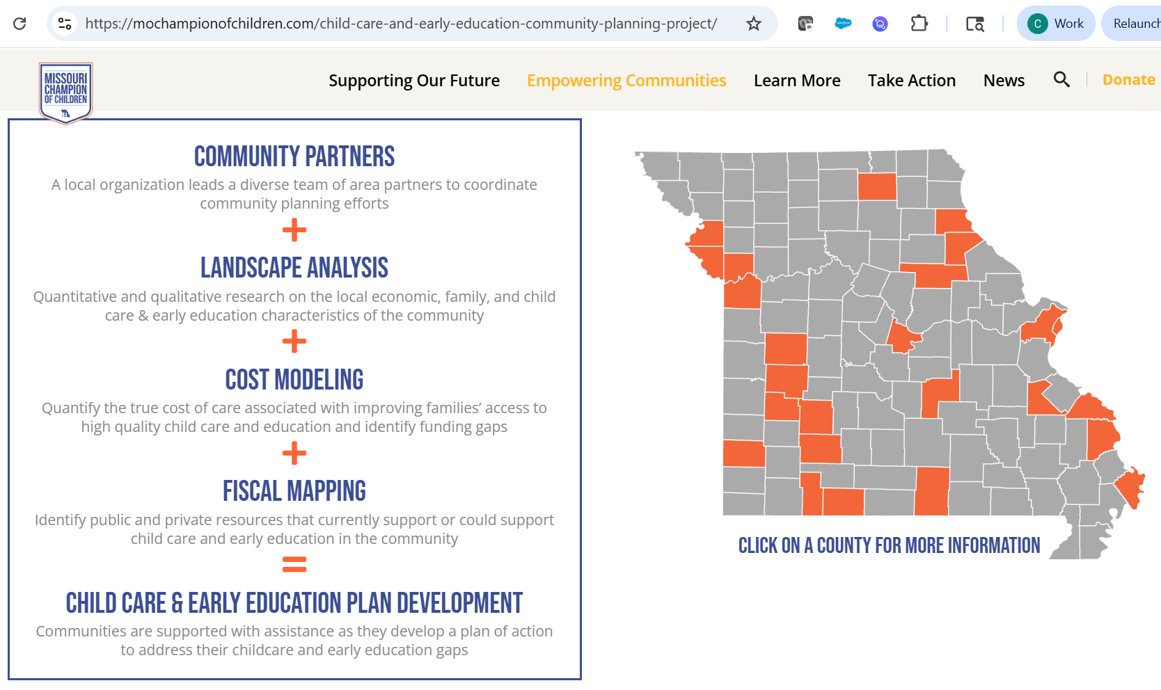
Child Care and Early Education Community Planning
19 communities throughout Missouri now on board!
https://mochampionofchildren.com

Slide 12

Child Care Works
7 communities awarded 287 seats with the first $2.5M
  More slots will likely be awarded after we have better info on utilization
Currently onboarding employers, providers and families
https://childcareworksmo.org

Slide 13
